Slide 1
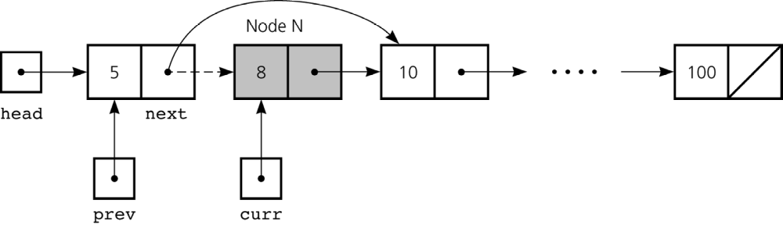
Deleting a node from a linked list

Slide 2
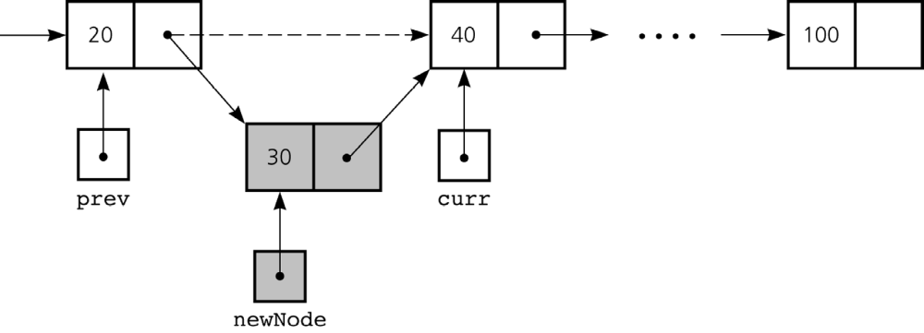
Inserting a new node into a sorted linked list

